Slide 1


Slide 2

學術與跨域學習
Academic and Interdisciplinary Learning
大學如何學
Guide to Studying at NTNU
楊承山 副教務長 主持
Dr. Chan-Shan Yang, Associate Vice President for Academic Affairs

Slide 3


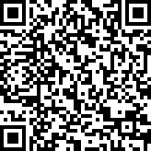
大學一定是讀四年嗎？
How long does it take to graduate?
大學只能拿一個學位嗎？
How many degrees can I get?
大學只能使用一種語言學習專業嗎?
Can I study in another language?
大學只能在臺灣讀嗎？
Do I always have to be in Taiwan to earn my degree?
大學畢業後進修管道？
Is there continuing education post-graduation?
檔案下載
大學只有在教室學嗎？
Does learning always have to be inside classrooms?
如何善用AI協作提升學習效率?
How to use AI collaboration to improve learning efficiency?

Slide 4


◆臺師大6學科進入QS全球百大，全臺第二
Six NTNU disciplines ranked in the QS global top 100, making it the second-highest in Taiwan.
◆躍升「雙語標竿大學」 全臺只有四所
NTNU has been elevated to a Bilingual Benchmark University — one of only four in Taiwan.
◆廢除二一退學制度，採全方位輔導機制
Abolish the dismissal policy for students who fail over half of their credits in a semester and adopt a comprehensive support system instead.
◆首創輔系、雙主修採登記制
Double Majors and Minors: Tiered Registration System.

Slide 5

雙主修、輔系、學分學程
Double Major , Minors , Interdisciplinary Programs
跨域跨校學分學程（62個）
NTU System Interdisciplinary Programs
專業學分學程（122個）
The Specialization Program
跨校雙主修
Intercollegiate
Double Major
跨校輔系
Intercollegiate Minors
跨域跨校
學分學程
NTU System Interdisciplinary Programs
40-50 學分 Credits
雙主修
Double Major
20-30 學分 Credits
輔系
Minors
修畢先修課程 Completing Prerequisite Courses
預修生
Preparatory Student

Slide 6
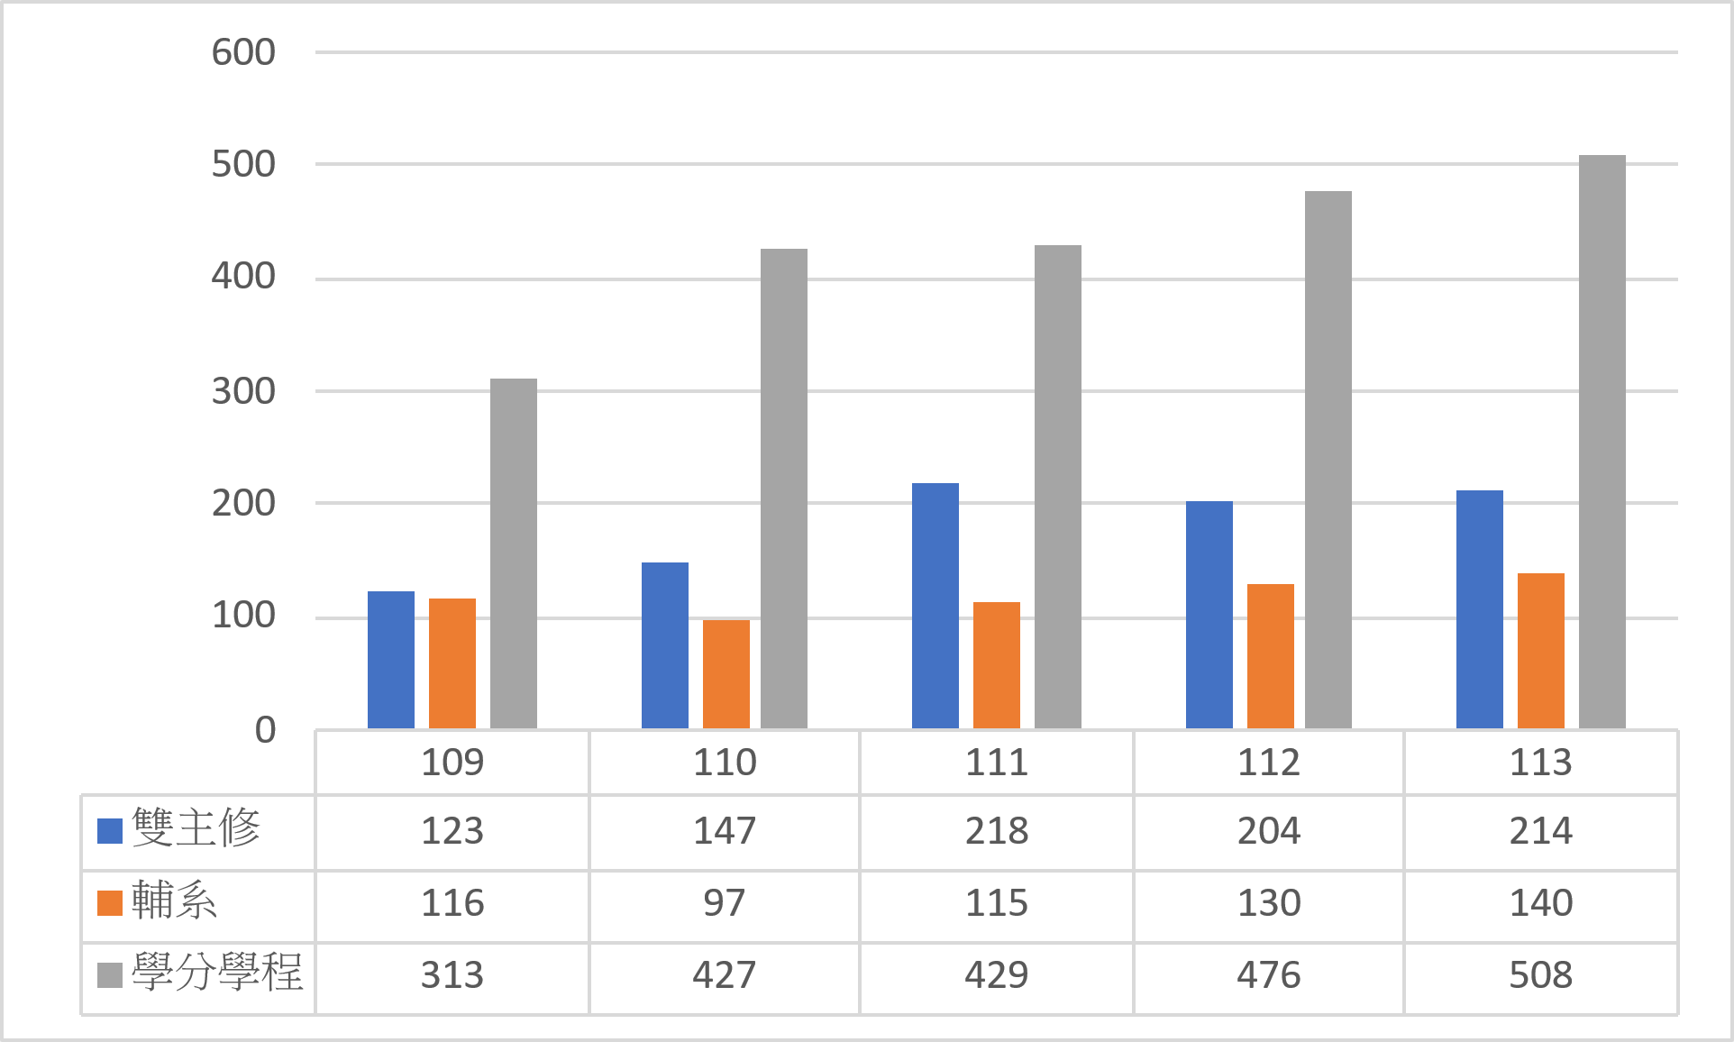
學生掌握自主，跨域彈性學習
Empowering Students with Autonomous and Cross-Disciplinary Learning
■修畢人數統計Number of Students Completed

Slide 7
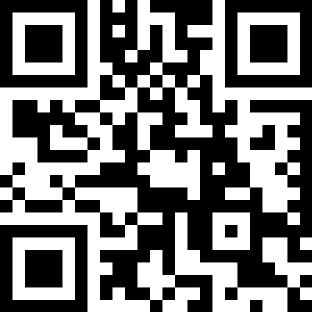





跨領域學士學位
The Interdisciplinary Bachelor’s Program
校學士簡介
Introduction
114年成立「跨領域學習規劃辦公室」，通籌推動「校學士」學位制度，陪伴學生探索跨域學習、打造專屬學習路徑。
校學士已招收兩屆學生，目前共有24位學生依興趣與職涯目標自主規劃跨領域學習，並自訂校學士修讀領域名稱，如「高齡產品創新與創業實踐」、「國際永續治理與綠能轉型」、「智慧互動與數據分析」、「地景與資訊應用」等。
修讀形式：
一、 1個輔系＋2個學分學程
地理學系(輔系)
資訊科技應用學分學程
電腦音樂與音訊技術學分學程
二、 4個學分學程
人工智慧技術與應用學分學程
資訊科技應用學分學程
AI與數位藝術學分學程
商業分析學分學程
2. four credit programs
Established in 2025, the Interdisciplinary Academic Advising Office (IAAO) oversees the Interdisciplinary Bachelor's Program (IBP), supporting students in exploring interdisciplinary learning and designing personalized learning pathways.
The IBP has admitted two cohorts of students. Currently, 24 students are pursuing individualized interdisciplinary studies based on their interests and career goals. Students may also define their own fields of study, such as Product Design and Entrepreneurship, International Sustainability Governance and Green Energy Transition, Intelligent Interaction and Data Analytics, and Landscape and Information Applications.
Program Structure:
1. One Minor + Two Programs
Minor: Department of Geography
The Inter-disciplinary Program of Application of Information Technology
The Inter-disciplinary Program of Computer Music and Audio Technology
2. Four Programs
The Inter-disciplinary Program of Technology and Application of Artificial Intelligence
The Inter-disciplinary Program of Application of Information Technology
The Inter-disciplinary Program of AI Digital Art
The Inter-disciplinary Program of Business Data Analysis

Slide 8


國立臺灣大學系統 學生跨校選課情形
NTU System students taking inter-university courses
■ 114-1跨校選課人次 Course Enrollments, Fall 2025
NTNU → NTUST
516 (11.57%)
NTNU → NTU
1,038 (23.28%)
NTU → NTNU
1,187 (26.62%)
NTUST → NTNU
366 (8.21%)
NTUST → NTU
557 (12.49%)
NTU → NTUST
795 (17.83%)
選課總人次
Total
4,459
修課人次 Course Enrollments
■ 114-2跨校選課人次 Course Enrollments, Spring 2025
NTNU → NTUST
563 (12.43%)
NTNU → NTU
1,058 (23.36%)
NTU → NTNU
1,208 (26.67%)
NTUST → NTNU
280 (6.18%)
學年 Academic Year
NTUST → NTU
597 (13.18%)
NTU → NTUST
823 (18.17%)
Note: Percentages may not sum to 100% due to rounding.
選課總人次
Total
4,529

Slide 9
國立臺灣大學系統 整合不同優勢與資源
The NTU System integrates various strengths and resources.
改變眾多年輕人的人生
Making a Difference in the Lives of Many Young People
校別Partner universities | 跨校 輔系 Intercollegiate Minors |  |  |  | 跨校 雙主修 Intercollegiate Double Major
 | 開放 學系數 Number of Participating Departments | 申請 人次 Number of Applications | 錄取 人數 Number of Accepted Students | 通過率 Acceptance Rate | 開放 學系數 Number of Participating Departments | 申請 人次 Number of Applications | 錄取 人數 Number of Accepted Students | 通過率 Acceptance Rate
臺師大 NTNU | 27 | 41 | 18 | 44% | 24 | 26 | 11 | 42%
臺大 NTU | 17 | 42 | 17 | 40% | 9 | 20 | 5 | 25%
臺科大 NTUST | 13 | 32 | 16 | 50% | 10 | 26 | 8 | 31%
■114學年統計Statistics for the 2025–2026 Academic Year

Slide 10
循序提升英語能力 穩健發展EMI課程
Step-by-Step English Enhancement, Steady EMI Growth
EMI
各院專業領域全英語授課
Specialization Courses Taught in English
ESP
提升專業領域之學術英語能力
English for Specific Purposes
EAP
提升基本核心英文能力
English for Academic Purposes
課程學習
Curriculum

Slide 11
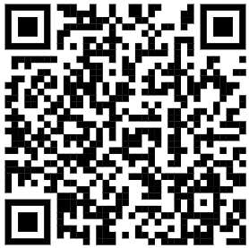













英語增能活動 Creating an Immersive English Learning Environment
z
學術英語
寫作諮詢
Academic English Writing Support
學術英語
口說諮詢
Academic English Speaking Support
學術/EMI
團體諮詢
Academic English Group Consultation
學術英語入班分享
Academic English In-class sharing
學術英語
講座/工作坊
Academic English
Lectures & Workshops
融入AI
科技工具
AI Integration
學術英語
自學資源
Academic English
Self-learning Resources
掃碼看更多
Scan CAL FB for more!
中心來自不同領域的專業輔導員團隊
CAL has a team of professional tutors with expertise in diverse academic fields.
中心提供豐富自製學術英語寫作、口說自學資源
CAL offers a rich collection of self-developed resources for self-learning in academic English writing and speaking.

Slide 12
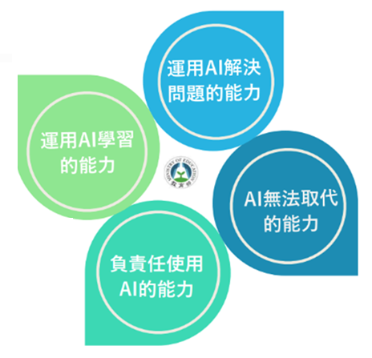
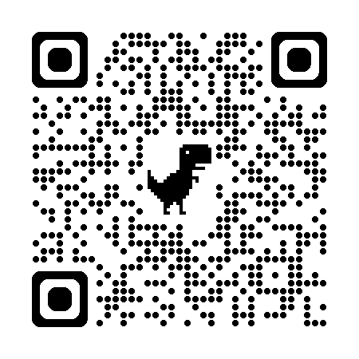
從 AI 素養到未來學習力 From AI Literacy to Future Learning Skills
教育部未來人才
AI能力圖像
本校人工智慧應用教學指引
AI驅動課程轉型
學生學習與負責任使用AI：
遵循課程AI使用規範
誠實揭露AI使用情形
維護學術誠信與自主學習
落實資訊查證與成果負責
AI應用之智慧財產權與學術責任
資訊安全與個人隱私
避免過度依賴AI
引用格式與文獻標註
全校AI課程盤點
邏輯運算領域增設2學分「AI素養與倫理」，奠定學生AI基礎
共同國文「中文閱讀與思辨」納入本校指引，並使用「無限閱讀眼鏡」等AI時代閱讀與思辨相關文本。
「 共同英文」學術英文與AI協作學習(TEEMI)
「X+AI」與「AI+X」雙向探索
推動「AI＋X」學系學分學程，深化AI與專業領域之整合應用。
教學助理接受AI基礎培訓，運用AI協助教學與學習輔導。
檔案下載
本校受教育部委託，擔任「未來人才AI能力圖像」北區AI資源中心，執行課程盤整、資源共享、教學支持、教師支持、諮詢輔導及特色發展等面向。
AI 應用教學指引

Slide 13
逕修讀博士人數
Direct Admission to Doctoral Program
歷年 合計Cumulative Headcount | 類別 Category | 校內 Within NTNU | 跨校 Inter-university
 | 學士逕讀博士 Direct Admission (BA/MS to PhD) | 6 | 2 臺師NTNU→台大NTU
 | 碩士逕讀博士 Direct Admission (MA/MS to PhD) | 81 | 3 臺科NTUST→台大NTU 4 臺師NTNU →台大NTU
■108-114學年度歷年合計人數Cumulative Headcount: Academic Years 2019–2025

Slide 14
提早規畫個人學習地圖 Plan Your Study Ahead
Advanced Proficiency
B2-C1
專業領域英文 Disciplinary English
EMI
各院專業領域全英語授課 English as a Medium of Instruction
EMI in professional courses
High Proficiency
B2
專業英文 Specific English
ESP
提升專業領域之學術英語能力 English for Specific Purposes
Enhance academic English proficiency in professional fields
Average Proficiency
B1-B2
學術英文 Academic English
EAP
提升基本核心英文能力 English for Academic Purposes
Enhance core English competency
大一 Freshmen Year
大二 Sophomore Year
大三 Junior Year
大四 Senior Year
系所與自己的志趣相符?
Does your major match your interests?
加修雙主修、輔系、學分學程?
Double major? Minors? Interdisciplinary Programs?
準備考托福、多益、英檢?
Prepare for English proficiency exams such as TOEFL, TOEIC, etc.?
想出國當交換生?
Apply for the Exchange Programs?
想修習雙聯學位?
Joint Degrees?
想提早畢業？
Consider early graduation?
申請逕讀博班或學碩五年連修？
Apply for Direct Admission to Master’s or Doctoral Programs?
國內進修或出國留學？
Study domestically or abroad?
考研究所
Apply for graduate schools
申請國外學校
Apply to study abroad
準備就業
Find a job
大學入門
Introduction to University Studies
總整課程
Capstone Course

Slide 15
學會思考
生涯規劃
擁有信念、自由選擇
從進大學第一天開始！
PLAN AHEAD, HAVE FAITH, FOLLOW YOUR HEART
Today is your best starting point!

