Slide 1
課 業 篇
一本指引你如何亮麗畢業的小手冊

Slide 2
大學一定是讀四年嗎?
大學只能在臺灣讀嗎?
(1)畢業要求
(2)修課規定
(3)選課策略
(4)校際選課
(5)如何提早畢業?
(6)為何會延畢?
(7)階段性規劃與學習地圖
(1)雙聯學位
(2)交換生
(3)本校各類境外短期研修補助
(4)海外留學
大學畢業後進修管道?
大學只能拿一個學位嗎?
(1)參加甄試或考試進入碩士班就讀
(2)連續修讀學、碩、博士學位
(1)本校雙主修、輔系
(2)跨校雙主修、輔系
(3)學分學程
面對 AI 時代來臨，師大生絕不能錯過的一堂課！
(4)教育學程
CH 6
大學只有在教室學嗎?
(1)Moodle 數位學習平臺
(2)圖書館
(3)課業輔導學習社群
(4)自主讀書會
(5)研討會、工作坊、講座
(6)產業實習
大學專業只能使用一種語言學習嗎?
共同英文課程架構介紹：英文(一)、英文(二) 、英文(三)
英語增能活動
(3)英語學術寫作與口說諮詢
(4)英語讀書會
(5)英檢補助
CH 7
哪些行為違反了學術倫理呢？
CH 8
學習地圖

Slide 3
How long does it take to graduate?
Do I always have to be in Taiwan to earn my degree?
(1)Graduation Requirements
(2)Course Selection Regulations
(3)Course Selection Strategies
(4)Cross-University Course Selection
(5)How to Graduate Early?
(6)Causes of Delayed Graduation
(7)Stage-based Thinking and the Learning Map
(1)Joint Degrees
(2)Exchange Students
(3)Short-term International Exchange Funding
(4)Going Abroad
Continuing education post-graduation
How many degrees can I get?
(1)Applying to Master’s Program
(2)Direct Admission to Master’s and Doctoral Programs
(1)Double Major , Minors
(2)Cross-University , Minors
(3)Credit Programs
(4)Teacher Education Program
CH 6
Does learning always have to be inside classrooms?
(1)Moodle – A Digital Learning Platform
(2)Libraries
(3)Study Groups
(4)Reading Groups
(5)Conferences, Workshops, Lectures
(6)Industry Internships
Can I study in another language?
(1) Introduction to the Common Core English Course Framework: English I, English II, and English III
(2) English Enhancement Activities
(3) English Academic Writing and Speaking Consultation
(4)English Reading Group
(5) English Certification Exam Subsidy
CH 7
What will violate academic ethics?
CH 8
The Learning Map

Slide 4
大學一定是讀四年嗎?
學長姐分享
我知道很多人對於延畢的第一印象都比較糟，其實在我延畢之前，我也是這樣想的。但因為在大學四年中我修了教育學程，也利用機會出去國外交換，在這樣的過程與結果下，我延畢後學到的東西，比原本完整的大學四年還要多。
舉例來說，在系上很多人會覺得修習教育學程非常麻煩，更不用提之後還要上台試教、進行學校及行政實習。但每年有很多人是為了取得教育學程的資格而努力，多花了時間學習，就是培養自己多獲得一項技能，也是我認為身為師範體系下的學生，應該追求的權利和資格。
考慮到底要不要出國交換，是一件大費周章的事情：優點是能出去看看廣大的世界，並學習到不同國家的文化；而缺點是事前準備工作不少，出國也可能衍生適應不良等問題。更重要的是，學分若沒有算清楚，那就不只是延畢一年這麼簡單了。
大學並不是只有讀四年這個選項：對我來說，延畢並不是一件丟臉的事情，而是擁有更多學習機會的展現。在這裡與各位學弟妹共勉之，希望你們都能找到最適合自己的人生安排。
國文學系

Slide 5
How long does it take to graduate?
Experience Sharing
I know that most people tend to think negatively about delaying graduation. Actually, I also thought so before I delayed my own graduation. But in the four years of college, I have completed a teacher education program, and also took the opportunity to go abroad for exchange. In the end, what I have gotten by delaying my graduation was a lot more than what I would have gotten if I graduated on time.
For example, a lot of people in my department thought that it was a lot of hassle to complete the teacher education program, not to mention the need to go student-teach, and intern in schools and administration. But many people still worked very hard to be qualified in Teachers Education. They spent a lot of extra time to learn, just to cultivate one extra skill. I think this is a right and a qualification that a student in the normal university system should be pursuing.
Whether or not to go abroad for exchange is a complicated issue. The bonus is I will be able to go and see the world, and learn the cultures of different countries. The down side is there is a lot of preparation work. Going abroad may also lead to problems like maladaptation. The most important thing is, if they did not calculate the credits right, it would not be as simple as just delaying graduation for a year.
The choice of not finishing college in four years: To me, delaying graduation is not something to be ashamed of. Instead, it is a manifestation of having more learning opportunities. I hope all the students who come after me will find a plan that best suit their needs.
Dept. of Chinese

Slide 6
大學一定是讀四年嗎?
畢業總學分
最低128學分
自由選修學分
學分學程12-20學分
輔系20-30學分
雙主修40-50學分
國際學習學分採計
(1)畢業要求
恭喜！也歡迎你成為師大大家庭的一分子，想必同學應該對大學生活充滿了想像，並摩拳擦掌準備精彩出擊。
在盡情享受大學美好學習階段，先讓您知道要如何才能取得大學學位證書，做了以下扼要說明圖示，建議善用21學分的自由選修，為你的學習加值唷。
學系必選修
75學分
基本要求：修畢128學分
*含通識、體育、學系必選修、自由選修、服務學習+各學系所訂之畢業條件
(如外語能力、實習等)。
中文思辯與表達4學分
英文6學分
通識18學分
體育4學分
服務學習課程
共同必修
32學分
【國立臺灣師範大學 學士班修業學分架構圖】

Slide 7
How long does it take to graduate?
Min. 128 Credits Required to Graduate
(1) Graduation Requirements
Electives
Credit Programs 12-20 Credits
Minors 20-30 Credits
Double Major 40-50 Credits
International Learning Credits
Congratulations on becoming a member of the NTNU family!
With all the excitement of leaving home and coming to college, the possibilities in your new life just seem endless.
But before you kick off on your newly independent life at NTNU, we have to let you know what it will take for you to get your degree. The figure below shows the distribution of credit hours for an undergraduate degree. We would suggest that you make good use of the 21 elective credits to further enrich your college experience!
Departmental Courses
(Required and Electives)
75 credits
Chinese Thinking and Expression 4 Credits
English 6 Credits
General Education 18 Credits
Sports Requirement 4 Credits
Service Learning Courses
Common Core
Requirements
32 credits
Basic Requirement: 128 Credits Required to Graduate
*Including General Education, Sports, Departmental Requirements, Electives, Service Learning + Other departmental graduation requirements (such as foreign language ability, internship etc.)
【NTNU Bachelor’s Degree Graduation Requirements】

Slide 8
大學一定是讀四年嗎?
厚植外語能力
學生即使修畢128學分，如未符合各學系、學位學程所訂之其他畢業條件(如外語能力畢業資格等)，也無法拿到畢業證書。
外語能力對你未來的發展非常重要，建議你一定要逐年有計畫地提升自己的外語能力。
學校為協助同學提升英語能力，提供不少學習資源，例如共同教育外文組的英語增能活動、英語學術寫作及口說諮詢、圖書館的語言學習資源及英語檢定補助(詳見CH4)。

Slide 9
How long does it take to graduate?
Strengthen Foreign Language Proficiency
Even if the student has earned 128 credits, he/she will not be eligible for graduation if departmental/degree program requirements were not met (e.g., foreign language proficiency). This will prevent them from getting their diploma!
Foreign language proficiency is extremely important to your future. We strongly recommend students to come up with a foreign language improvement plan.
To strengthen our students’ English proficiency, the university has provided many learning resources, such as the English enhancing activities of Foreign Language Division of Common Core Education, academic English writing and speaking tutoring, language learning resources from the library, and English certification exam subsidies (See Chapter 4 for details).

Slide 10
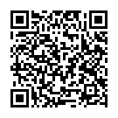
大學一定是讀四年嗎?
(2)修課規定
大一到大三每學期最少需修16學分，大四每學期最少需修9學分的課程。
低於此規定又沒有申請減選課程，會被強制休學喔！
每學期修習學分數規定─(學則§13)
除應屆畢業年級不得少於九學分外，各年級不得少於十六學分，不得多於 二十七學分。但若因特殊情況，經系主任核可者，不在此限。
(3)選課策略 - 智者千言一如醍醐；善規劃，得不困。
●課表規劃：依照修業規定及課程規劃每學期課表。盡量在低年級時掌握共同科、通識、跨域探索課程以及基礎課程，至中高年級時更能彈性運用空堂時間修讀其他有興趣之課程、申請赴外交換或提前畢業。
課務組02-7749-1114
更多訊息請見教務處選課專區http://www.aa.ntnu.edu.tw/course/super_pages.php?ID=0course101&Sn=8
●了解選課規則：你知道期末課程意見調查填答率將影響第一、二階段的分發排序嗎？你知道每學期僅能修一門體育課嗎？請務必掌握選課規則，制定專屬於自己的選課策略，以選到更多心目中的課程!
想要一次選到更多心目中理想的課程，請掌握...
第一階段 | 體育、通識、教程填寫志願分發，宜多填選志願增加分發成功機率。 了解分發順序(必→體→教→通→選→系統學校)，避免分發衝堂。
第二階段 | 善用登記學分上限，填選多門課程增加分發成功機率
全校加退選階段 | 善用授權碼，注意授權碼使用規定
Notes:
課務組可欣

Slide 11
How long does it take to graduate?
(2) Course Selection Regulations
A minimum of 16 credits per semester must be maintained for the first three years of students’ undergraduate studies. In the last year of their study, undergraduate students must take on at least 9 credits per semester. Students who fail to maintain this minimum levels of credits without applying for credit hour reduction may be suspended from their studies.
Regulations on Credit Course Load
With the exception of graduating students, all undergraduates should take no less than 16 credits, and no more than 27 credits per semester. Graduating students should take no less than 9 credits per semester. Exceptions can be made with the permission of the department chair.
(3) Course Selection Strategies
It is a student’s right to seek and receive help from their academic advisors regarding their future life plans and course selections. Students should know what courses are offered in the coming semester, be familiar with all the rules regarding the different stages of course selection, and plan ahead based on their future goals.
Curriculum Division
02-7749-1114
For more information, please see the Course Selection page on the Office of Academic Affairs website.
http://www.aa.ntnu.edu.tw/course/super_pages.php?ID=0course101&Sn=8
To get into the courses you want, please…
First Stage | List as many courses as possible in your course wish list for Sports, General Education, and Teacher Education Courses. The more courses you put on your course wish list, the higher the chance you have for getting into the courses you want. Understand course assignment’s order of precedence (Requirements → Sports → Teacher Education → Common Core → Electives → Courses of NTU System Universities)
Second Stage | Make use of the maximum credit limit. The more courses you put in your course wish list, the higher the chance you have for getting into the courses you want.
University-Wide Stage | Make use of course authorization codes. Familiarize yourself with the rules on authorization code use.
Notes:
課務組可欣

Slide 12
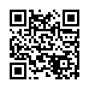
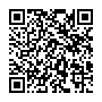
大學一定是讀四年嗎?
(4)校際選課-- 你也是國立臺灣大學系統的一員（NTU System）
藉由校際選課，跨域學習並拓展視野。
國立臺灣大學系統課程：在師大的選課系統直接選課，亦得向授課教師申請核發該校課程授權碼；未在選課系統上之課程，為其他兩校不開放之課程，如取得授課老師同意，得請老師開放三校名額或以授權碼加選。
其他學校課程：只要是當學期本校沒開之課程，都可以在系所主管同意下，申請校際選課，但申請前須先了解校際選課規定與截止日期。
通則：
1.校際選課不超過畢業學分數三分之一。
2.當學期本校沒開課程始可校際選課。
國立臺灣大學系統成員：國立臺灣大學、國立臺灣師範大學、國立臺灣科技大學。
NTU System國立臺灣大學系統 https://triangle.ntu.edu.tw/
本校學生選修臺灣大學系統課程說明：http://www.aa.ntnu.edu.tw/course/super_pages.php?ID=0course101&Sn=177
課務組：02-7749-1114

Slide 13
How long does it take to graduate?
(4) Inter-University Course Selection-- You are also a member of the National Taiwan University System (NTU System)
Learning without borders! In addition to courses from NTNU, taking courses from other universities can also enhance your learning! All courses made available to the NTU System are also available in the NTNU course selection system. Any course not found in the course selection system is not open to NTNU students. In the case, students may request for an authorization code from the course instructor to enroll in these courses if needed.
For courses offered in non-NTU System universities, under the condition that a similar course is not offered in NTNU in the current semester, students may apply for cross-university course selection with the permission of the department chair. Students should know the rules regarding inter-university course selection and relevant deadlines before applying.
General Rules:
Credits earned through non-NTNU courses should be no more than one-third of the minimum total graduation credits.
Inter-University course selection will only be approved for courses not offered by NTNU during the semester concerned.
NTU System Universities: National Taiwan University, National Taiwan Normal University,
National Taiwan University of Science and Technology
NTU System https://triangle.ntu.edu.tw/
Instructions for NTU System Course Selection：http://www.aa.ntnu.edu.tw/course/super_pages.php?ID=0course101&Sn=177
Curriculum Division：02-7749-1114

Slide 14
大學一定是讀四年嗎?
(5)如何提早畢業?
如果你的興趣明確、職涯進路清楚，那你可以考慮盡快完成畢業條件「提早畢業」，
提前進入職場卡位、進修研究所、或出國留學。
可提前畢業條件二擇一(學則§15) | 提前離校期程
1、歷年學業等第積分平均（GPA）達3.38以上。 | 可於大三下學期或大四上學期提出當學期畢業之申請。
2、歷年學業成績名次該系年級班生數前40%以內。
提前畢業同學的特質…
.清楚的學涯規劃
.善於請教師長及學長姐
.明瞭學校及學系的規定
.勤於自學
.嚴謹的時間管理

Slide 15
How long does it take to graduate?
(5) How to Graduate Early?
If you have a clear idea of what your interests are, where you want to go career-wise, you may consider early graduation. This will give you a head start in life, whether it is entering the career field of your choice, applying for graduate schools, or continuing your studies abroad.
Requirements for Early Graduation (must meet at least one of the following) | Timeline
1. Cumulative GPA is 3.38 or above | Application for early graduation may be submitted in the second semester of the junior year or the first semester of the senior year.
2. Cumulated class ranking is in the top 40% of the department
Characteristics of Students Who Gradated Early
Have a Clear Academic Plan
Are not afraid to seek help from professors and other students
Understand the Rules of the University and Department
Are highly motivated to learn
Manage Time Well

Slide 16
大學一定是讀四年嗎?
(6)為何會延畢?
你也可能無法4年畢業，延畢的原因不見得都是不好的，但青春短暫，請珍惜，並妥為自我管理 。
造成延畢的原因 | 延長修業期程
1、跨領域多元學習：如雙主修、輔系、學分學程、教育學程 | 可於學士班修業4年結束後，最多再延長修業期限2年。
2、個人生涯規劃：如出國交換
3、因未符合學系、學位學程所訂的各項畢業條件
叮嚀提醒~~為避免非自願延畢，請牢記以下心法：
.畢業條件門檻了心胸
.覓求個人學習真興趣（志趣相投的學系與課程）
.生活作息管理需得當
.困擾因素即尋求協助（如課業、家庭、健康、感情…等）
.學習遊憩分配宜合理

Slide 17
How long does it take to graduate?
(6) Causes of Delayed Graduation
Maybe you too, would not graduate in four years. While delaying one’s graduation is not necessarily a bad thing, it should always be purposeful and planned.
Causes of Delayed Graduation | Extension
1. Interdisciplinary Learning: Double Major, Minors, Credit Program, Teacher Education Programs | For bachelor’s degree, at the end of their 4th years in the university, students may extend their study for 2 more years.
2. Personal Plans: Such as going abroad for exchanges 3. Failure in meeting the graduation requirements of the department or the degree program
1. Interdisciplinary Learning: Double Major, Minors, Credit Program, Teacher Education Programs
To graduate on time, please keep the following in mind:
Be familiar with graduation requirements
Find your true passion (in your major and courses)
Maintain a healthy daily routine
Seek help if you have any problems (e.g., study, family, health, love-life, etc.)
Maintain a study-life balance

Slide 18
大學一定是讀四年嗎?
(7)階段性規畫與學習地圖
大四
考研究所
申請國外學校
準備就業
大三
想提早畢業?
申請逕讀博班或學碩五年連修?
國內進修或出國留學?
大二
想出國當交換生?
想修習雙聯學位?
大一
系所與自己的志趣相符?
加修雙主修、輔系、學分學程?
準備考托福、多益、英檢?
階段性規畫及思考重點

Slide 19
How long does it take to graduate?
(7) Stage-based thinking and the learning map
Senior Year
Apply to graduate schools
Apply to study abroad
Find a job
Junior Year
Consider early graduation
Apply to Direct Admission for Master’s or Doctoral Programs
To continue further studies domestically, or go abroad?
Sophomore Year
Go abroad as an exchange student?
Joint Degrees?
Freshmen Year
Does your major match your interests?
Double major? Minor? Credit Programs?
Take relevant tests such as TOEFL, TOEIC etc.
Stage-based Planning and Key Thinking Points
Notes:
Senior Year
Apply to graduate schools
Apply to study abroad
Find a job
Junior Year
Consider early graduation
Apply to Direct Admission for Master’s or Doctoral Programs
To continue further studies domestically, or go abroad?
Sophomore Year
Go abroad as an exchange student? (Please contact the Office of International Affairs)
Take relevant tests such as TOEFL, TOEIC etc.
Freshmen Year
Does your major match your interests?
Double major? Minor? Credit Programs?
Change your major? Transfer to other universities?
Stage-based Planning and Key Thinking Points

Slide 20
大學只能拿一個學位嗎?
學長姐分享
雙主修，就是主修兩個系，如果順利畢業就會得到兩個學士學位。
我今年圖傳系大四，很喜歡設計、多媒體、傳播的領域，同時也很喜歡商業，貪心的我最後決定雙主修企管系。
師大學生畢業前要修128學分，而我則要修近200學分，儘管課業壓力大，但視野也一下子變大了，認識了很多的新朋友，也發現隔行如隔山，兩個領域差異竟這麼大，卻同時有這麼多新知識值得我探索。
未來的就業市場掀起了對「π型人才」的需求熱潮，這種類型的人能適應現在千變萬化的環境，因為他們同時熟悉兩項專業，同時又能多方了解其他領域，讓兩個專業可以互相支援。如果你想成為π型人才，或者單純興趣廣泛，雙主修、輔系或學分學程都是很好的選擇。
難得大學一次，當然要好好把握學習的機會啊！
圖文傳播學系

Slide 21
How many degrees can I get?
Double majoring is having two majors. If successful, I will get two bachelor’s degrees instead of just one.
I’m a senior in the Department of Graphic Arts and Communications. I love the fields of design, multimedia, and communication. I also like business. The greedy side of me decided that I will double major in Business Administration.
Although it was quite stressful, my horizon has also widened. I met a lot of new friends. I also realized just how big the gulf is between the two fields. At the same time, I also found a lot of new knowledge worth of exploring.
There is a surge in demand for π-shaped talent in the future job market. This kind of people can adapt to all kinds of circumstances because they are not only well-versed in two specializations, but can also understand various other fields. This will allow each specialization to make up what the other lacked. If you want to be a π-shaped person, or simply have a wide range of interests, double majors, minors, or credit programs will all be good choices for you.
Going to college is a once in a lifetime opportunity, so of course you should grab the chance to learn as much as you can!
Experience Sharing
Dept. of Graphic Arts and Communications

Slide 22
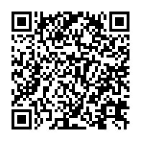
大學只能拿一個學位嗎?
預修生
雙主修
輔系
自110學年度起，本校雙主修、輔系改採預修生制度。
本校學士班學生(不含延畢生)， 只需修畢且通過學系規定之先修課程，即可登記為加修學系之預修生，未來如持續修習課架一定學分(輔系8學分；雙主修16學分)後，即可由系統判斷轉換為輔系生或雙主修生資格。
（40-50學分）
（20-30學分）
修習通識跨域探索「第一門課」，幫助你探索自己的第二專長
通識新制課程架構中，「學院共同課程」與「跨域專業探索課程」2類，即為各學系為雙主修、輔系學生所規劃的「第一門課」。
各系雙主修和輔系課程架構的「第一門課」，可採計為通識課程學分，並作為雙主修、輔系課架中的規定學分計算。
修畢跨域探索的「第一門課」後，若對該領域感興趣，可進一步申請加修學系預修生；若發現興趣不足，仍可採計為通識學分，一舉數得。讓你有效學習，觸發跨域興趣探索。
詳情請參閱通識教育中心網站公告。
修畢先修課程
(1)本校雙主修、輔系
申請方式 | 修習學分數 | 備註
得於校定行事曆期程，依教務處及各學系公告之相關規定辦理預修生登記。 部分學系採甄選制。 | 雙主修：40-50學分 輔 系：20-30學分 | 登記以1個為限
(2)跨校雙主修、輔系
申請方式 | 修習學分數 | 備註
學生向開放校系提出申請，以本校未開設學系為限，並經雙方校系同意。 全部採甄選制。 | 依加修校系所訂雙主修、輔系科目及學分數。 | 併同本校輔雙個數計算
Notes:
1110222註冊組淑珍姐更新

Slide 23
How many degrees can I get?
preparatory student
Double Major
Minor
NTNU undergraduates years 1-4 (not including delayed graduation students) only need to complete and pass the preparatory courses specified by the relevant department to register as a preparatory student of the department. If the student continues to study within the department’s curriculum, accumulating eight (8) credits for a minor or 16 credits for a double major, the system will automatically determine if the student qualifies for a minor or double major in the department to which they transferred.
(40-50 Credits)
(40-50 Credits)
(20-30 Credits)
(20-30 Credits)
Taking the “First Course” for General Education Cross-domain Exploration to help you find your second specialization.
The new interdisciplinary General Education scheme will apply to the incoming freshmen of the 2020 academic year. In the new scheme, “College Common Course” and “Cross-domain Professional Discovery Course” are two types of courses that are designed to be the “first course” for students interested in double majoring and taking on minors.
The “first course” in each department’s double major and minor curriculum framework can be counted towards both General Education credits and the required number of credits for the major or minor.
After completing their “first course”, students may choose to register as a preparatory student of the department if they found the field interesting. If that is not the case, the course may still be counted as a general education credit. So students can be free to explore different fields without any worries.
For details, please refer to the announcements on the Center for General Education website.
completing “first course”
completing “first course”
Double Major , Minor
How to apply? | Number of Credits | Max. Number
See announcements from departments and the Office of Academic Affairs. Application and departmental approval required for certain majors. | Double Major : 40-50 credits Minor : 20-30 credits | One double major or minor only including Interdisciplinary Learning.
(2) Cross-University , Minor
How to apply? | Number of Credits | Max. Number
Apply to each respective university. The minor should be in a field (department) that is not available in NTNU, and should be approved by both NTNU and the receiving university. Application and departmental approval required for all majors. | Complete the required courses and the number of credits. | One double major or minor only including Interdisciplinary Learning.
Notes:
1110222註冊組淑珍姐更新

Slide 24
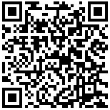
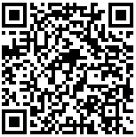
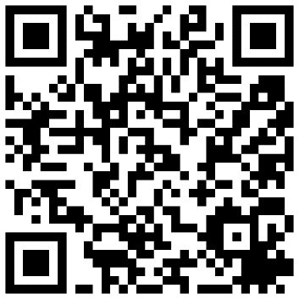
大學只能拿一個學位嗎?
(3)學分學程
(3)學分學程
想讓自己成為炙手可熱的跨域人才嗎？
師大規劃有九大主題─教育發展、商業管理、科技應用、資訊應用、專業領導、語言文學、文化創意、社會科學、國際交流，許多跨領域的學分學程供你選擇！ 快來看看有哪些吧！
依照各學程要求，修滿規定學分數即可申請學程證明書。
主題類別 | 學分學程名稱
教育發展 | 學校心理學、原住民族教育文化、哲學、國際教師(註)、社區高齡服務人才培力、PASSION偏鄉優質教育、音樂輔導與特教
商業管理 | 基礎管理、財務金融、大師創業
科技應用 | 環境監測與防災、區域與觀光規劃、人工智慧技術與應用、運動傷害防護、科學計算、太陽能源與工程、天文與重力、理工創新與實作
資訊應用 | 空間資訊、大數據資料與數位評量、資訊科技應用、學習與資訊
專業領導 | 社團人專業領導培力、金牌書院、戶外探索領導、產業實習學程
語言文學 | 榮譽英語、歐洲文化與語言、日本語文、韓國語文、文學創作、中英翻譯
文化創意 | 室內設計、數位人文與藝術、藝術產業、文物保存修復、知識轉譯與文化創生、電腦音樂與音訊技術、數位科技藝術
社會科學 | 社會與傳播應用
國際交流 | 國際足跡、全英語學程、國際外交學程
校內及跨校學分學程修習流程(https://program.cge.ntnu.edu.tw/修習流程/)
校內學分學程簡介
(https://program.cge.ntnu.edu.tw/學分學程/)
跨校學分學程：
師大學生可申請國立臺灣大學系統
跨校學分學程，有意申請者請詳見網頁公告(https://www.aca.ntu.edu.tw/UniversityAllianceProgram/ )
●備註：國際教師學分學程分為華語文教育、國際數學教育，國際物理教育、國際教育。
Notes:
1110221課務組麗雯更新

Slide 25
How many degrees can I get?
(3) Credit Programs
(3) Credit Programs
Do you want to be a highly sought after interdisciplinary talent?
NTNU is now offering interdisciplinary credit programs in 9 thematic fields, all for your choosing! So come and take a look!
Educational Development, Business Management, Technological Applications, Information Applications, Professional Leadership, Language & Literature, Culture & Creativity, Social Sciences, and International Exchange
Credit Programs are open to all majors. All current NTNU students may apply. Credit program certificates will be issued to those who have completed the required number of credits in accordance with the rules of each credit program.
Theme | Credit Programs
Educational Development | The Program of School Psychology, The Program of Indigenous Education and Culture, The Program in Philosophy, The Program of International Baccalaureate Educator Certificate, Program of International Baccalaureate Educator Certificate-Chinese Language Education, Program of International Baccalaureate Educator Certificate-International Mathematics, Program of International Baccalaureate Educator Certificate-International Physics Education, The program of Cultivating Seniors Service Talent in Community, The Program of PASSION Quality Education in Rural Schools
Business Management | The Program of Fundamental Management, The Program of Finance, Program of Entrepreneurship
Technological Applications | The Program of Environmental Monitoring and Disaster Mitigation, The Program of Region and Tourism Planning, The Program of Technology and Application of Artificial Intelligence, The Program of Injury Prevention and Athletic Training, The Program of Scientific Computation, The Program of Solar Energy Engineering
Information Applications | The Program of Geospatial Information Science, The Program of Big Data and Digital Assessment, The Program of Application of Information Technology, The Program of Learning Informatics
Professional Leadership | The Program of Club Members Leadership And Empowerment Cultivation, The Program of Elite Athletes College, The Program of Outdoor Adventure Leadership, Industrial Internship Program Of College Of Education
Languages and Literature | The Honors Program in Advanced English, European Cultures and Languages Program, The Program in Japanese as a Foreign Language, The Program in Korean as a Foreign Language, The Program of Literature Creation, The Program of Translation and Interpretation
Culture and Creativity | Interdisciplinary Program For Interior Design Profession, The Program of Integrating Digital Technology into Arts & Humanities, Interdisciplinary Program For the Arts Industry, The Program of Conservation of Cultural Relics, The Program of International Interdisciplinary of Art Innovation, The Program of Computer Music and Audio Technology, The Program of Digital Art and Technology
Social Sciences | Application Program in Society and Communication
International Exchange | Global Footprint Program, English as a Medium of Instruction Program, The Program of International Relations and Diplomacy
NTNU and Cross-University Credit Program Flowchart
(https://program.cge.ntnu.edu.tw/修習流程/)
Introduction to NTNU Credit Programs
(https://program.cge.ntnu.edu.tw/學分學程/)
Cross-University Credit Program: NTNU students may apply for NTU System Cross-University credit programs. Please see website announcements for details.
(https://www.aca.ntu.edu.tw/UniversityAllianceProgram/ )
Remark：Programmes of International Baccalaureate Educator Certificat with Chinese Language Education , International Mathematics , International Physics Education and International Baccalaureate Educator Certificate.
Notes:
1110221課務組麗雯更新

Slide 26
大學只能拿一個學位嗎?
面對 AI 時代來臨，師大生絕不能錯過的一堂課！
基礎入門：通識「運算思維與程式設計」
專為無程式設計經驗的學生量身打造的「運算思維與程式設計」，帶你循序漸進學習運算思維，讓你明白程式運作方式。專題更能磨練你整合應用、溝通協作的能力，零基礎也能輕鬆上手！
課程特色：
優秀教師與助教團隊帶你入門
培養運算思維與問題解決能力
生活案例中實踐程式設計能力
專屬線上學習平台學習不受限
進階系列：
如果你已有程式設計基礎，想繼續朝專業方向發展，則可選擇通識「邏輯運算領域」之進階課程。
共同教育委員會邏輯與程式教育組02-7749-1121

Slide 27
How many degrees can I get?
A must-take general education course in the AI age!
Introduction-level: “Computational Thinking and Programming”
This course is designed for students with no programming experience. It will introduce computational thinking and help you understand how computer programs work and what they can do in daily living. You will develop skills including problem solving, programming, and collaboration through projects.
Features:
Cultivating computational thinking and problem solving skills
Applying programming skills in real-world cases
Top instructors and teaching assistants
Dedicated online learning platforms
Advanced Courses:
If you already have basic knowledge in programming, you may take advanced courses in the "Logic and Computing" field of general education courses, including “Data Science and Computer Programming”, “Fundamental Programming for Digital Music and Sound Synthesis”, and so on.
Computational Thinking and Programming Education Division (02) 7749-1121

Slide 28
大學只能拿一個學位嗎?
你知道嗎？修習「邏輯運算」領域通識課程後，還可進一步修習「人機共創系列」學分學程，結合資訊技術與人文、藝術、教育、工程等專業領域，發展你的第二專長！
通識「邏輯運算」領域課程地圖
人機共創學分學程
基礎知能
數位人文與藝術
學分學程
運算思維與程式設計
資訊科技與生活
必
必
必
必
必
資訊技術
學習與資訊
學分學程
選
選
選
選
選
資料科學與程式設計
遊戲程式設計
行動 APP 程式設計
試算表進階應用與程式設計
生活中的演算法
選
選
資訊科技應用
學分學程
跨域整合
人工智慧技術與應用學分學程
選
選
科學與程式設計
學程式玩音樂
文本分析與程式設計
運動數據分析與程式設計
數位音樂與聲音合成之基礎程式設計
共同教育委員會邏輯與程式教育組02-7749-1121
選
電腦音樂與音訊技術學分學程
另有兩門非邏輯組開設：
智慧型手機與開放軟體之日常物理學習
智慧生活小 app 開發(1 學分)

Slide 29
How many degrees can I get?
There are a variety of courses in the "Logic and Computing" field of general education. After taking these courses, you may also consider taking our Human-Computer Collaboration and Innovation credit programs that lead to you integrate information technology with several other professional domains such as humanities, arts, education, and so on.
Human-Computer Collaboration and Innovation Credit Programs
Credit Programs
Foundation Courses
The Program of Integrating Digital Technology into Arts & Humanities
R
R
R
R
R
Computational Thinking and Programming
Information Technology and the Way of Life
Information Technology
The Program of Learning Informatics
E
E
E
E
E
Data Science and Computer Programming
Learn to Code: Images, Animation, and Games
Mobile App Development
Advanced Applications of Spreadsheets and Programming
Algorithms in Daily Lives
E
E
The Program of Application of Information Technology
Interdisciplinary Courses
The Program of Technology and Application of Artificial Intelligence
E
E
Scientific Computing
Learning Programming for Music
Textual Data Analysis
Computer Programming and Data Analysis in Sports
Fundamental Programming for Digital Music and Sound Synthesis
E
Computational Thinking and Programming Education Division 02-7749-1121
The Program of Computer Music and Audio Technology
R: required
E: elective
Two other courses:
Smartphone and Open Source in Daily Physics Learning
App Inventor (1 credit)

Slide 30
大學只能拿一個學位嗎?
中等學校教師之培育歷程
(5)教育學程
修畢
普通課程
取得修習教育專業課程資格
修畢
專門課程
取得修畢師資職前教育
證明書
參加
教師資格
考試
資格考試通過
修畢教育專業課程
參加
半年教育
實習
實習期滿成績及格
取得教職成為專任教師
通過
參加
教師甄選
取得
教師證書
【備註】師資培育法新制 (107年2月1日施行)

Slide 31
How many degrees can I get?
(5) Teacher Education Program
Training Process for Qualified Secondary School Teachers
Complete all other required credit hours
Get admitted to the Teacher Education Programs
Complete Specialization Courses
Receive certification for the completion of Teacher Education Programs
Take the Teacher Qualification Exam
Pass the Exam
Complete Education Courses
Undergo 6 months of Educational Internship
Completion of Internship with Passing Grades
Becomes a fulltime qualified teacher
Pass
Apply for Teaching Positions
Receive Teacher Certificate
Teacher Education Act (Promulgated Feb. 1, 2018)

Slide 32
大學只能拿一個學位嗎?
師資職前教育課程
111學年度起中等教育專業課程
（至少26學分）
可加註雙語次專長(至少10學分)
普通課程
教育基礎
至少4學分
教育方法
至少8學分
教育實踐
至少8學分
指教師人文博雅及教育志業精神之共同課程
依各學系規劃之任教專門課程科目及學分一覽表修畢專門課程學分
(學分數依各學分表而有不同)
依教育專業科目及學分表修畢教育專業課程學分數
雙語教學師資培育課程
至少10學分
專門課程
教育專業
課程
詳見本校中等學校教育專業課程科目及學分表

Slide 33
How many degrees can I get?
Pre-service Teacher Education Courses
Teacher Education Program for Secondary Schools (From 2022)
（ at least 26 credits ）
Can be annotated a further specialty of bilingual teaching(at least 10 credits )
Other Required Courses
Humanities & liberal arts courses and common core courses that are aligned with teaching and education.
Education Foundation
Min. 4 credits
Instructional Methods
Min. 8 credits
Educational Practicum
Min. 8 credits
Courses required by the department of the student’s chosen field of specialization. The number of credits may vary from specialization to specialization.
Courses required by the education program the student has chosen.
Teacher Training Courses for Bilingual Teaching
Min. 10 credits
Specialization Courses
Education Courses
For details, please refer to NTNU’s Secondary School Education List of Professional Courses and Credits.
※ Only for domestic students

Slide 34
大學專業只能使用一種語言學習嗎?
雙語大學計畫及國家語言發展計畫
臺師大於2021年獲得教育部「大專校院學生雙語化學習計畫」重點培育學校，本校校務發展亦明定為培養本校同學成為全球公民，深化師生國際視野與國際移動能力，建立國際夥伴關係網絡。面對國際化及全球化新浪潮，英語是當前國際溝通最重要能力之一。本校以三階段執行英語授課計畫，從基礎英語學習課程（English for General Purpose, EGP）、專業領域之學術英語（English for Specific Purpose, ESP），跨接到各學院系所的EMI專業課程，透過循序漸進的方式，培養同學的英語學術素養。EMI相關學習規劃與資源，如後述。
此外，2022年本校訂定推動國家語言發展授課獎勵實施要點，同學亦可修習以臺語、客語、臺灣原住民族語、馬祖語及臺灣手語等語言授課的課程來學習知識。

Slide 35
Can I study in another language?
The Bilingual University Project and the National Language Development Project
NTNU was designated as a “The Program on Bilingual Education for Students in College” Focused Development School in 2021 by the Ministry of Education. The Strategic Development Plan of NTNU also stipulates to cultivate our students to become global citizens, intensify the international vision and mobility of our faculty members and students, and develop an international partnership network.
Facing new wave of internationalization and globalization, English proficiency is currently one of the most important abilities for international communication. NTNU implements English Medium Instruction (EMI) in three stages, starting from Foundational English Courses (English for General Purpose, EGP), Academic English in Professional Fields (English for Specific Purpose, ESP), to Cross-disciplinary EMI courses to cultivate students' English academic literacy.EMI related learning resources are described below.
In addition, in 2022, NTNU announced “Teaching Reward Implementation Guidelines for the Promotion of National Language Development” which promotes students can take courses taught in Taiwanese, Hakka, Taiwanese aboriginal languages, Matsu dialect, Taiwanese Sign Language, etc.

Slide 36
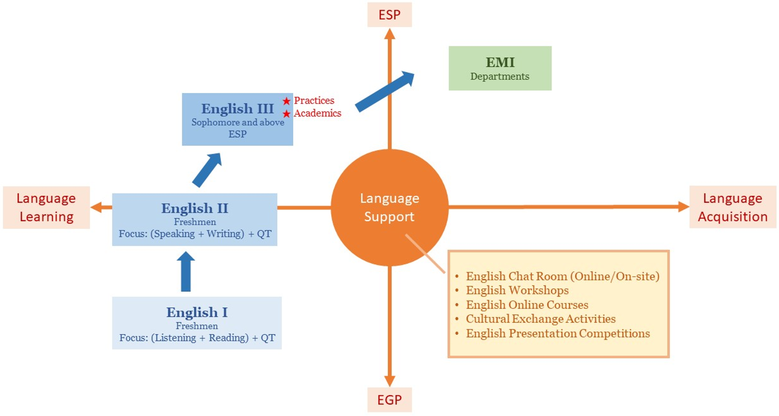
大學專業只能使用一種語言學習嗎?
(1)共同英文課程架構介紹：英文(一)、英文(二) 、英文(三)
101學年度之後入學新生，需先修畢英文(一)及英文(二)且成績及格者始得修習英文(三)，英文(一)及英文(二)課程以原班循序修習為原則，未修畢英文(一)者不得修習英文(二)。如英文(一)學期總成績不及格但等第達D(含)以上之學生，得於下一學期申請先修習英文(二)，再重修英文(一)，請多加留意。
英文(一)(二)課程目標為提升英語基本能力，分為基礎級、初級、中初級、中高級、及進階共五級，依入學成績跨系編班。英文(三)課程主題與各專業領域結合，並分為實務類和學術類供學生選擇修課，強化學生該領域之英語表達能力，加深批判與分析能力，為各系全英語授課課程做準備。

Slide 37
Can I study in another language?
(1) Introduction to the Common Core English Course Framework: English I, English II, and English III
New students enrolled after the 2022 academic year must complete and pass English I and English II before they can take English III. In principle, English I and English II will be taught in sequence with the same class. Those who have not completed English I will not be allowed to take English II. Please keep in mind that students who failed English I in accordance with their final grade, but still obtained a grade of D or above, may apply to take English II in the following semester, before retaking English I.
The goal of English I and II is to enhance foundational English proficiency so they are divided into five levels, including foundational, elementary, intermediate, high-intermediate, and advanced. Students are assigned to a class based on their admissions grade but not their department.
The goal of English III is to strengthen students' English expression ability in their professional field and deepen their critical and analytical abilities so that they can get ready for taking EMI course. Therefore, the themes of English III are integrated with each professional field and divided into practice and academic categories for students to choose.

Slide 38
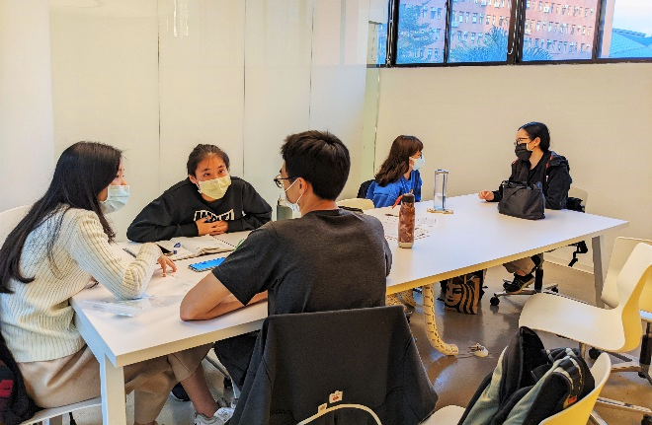
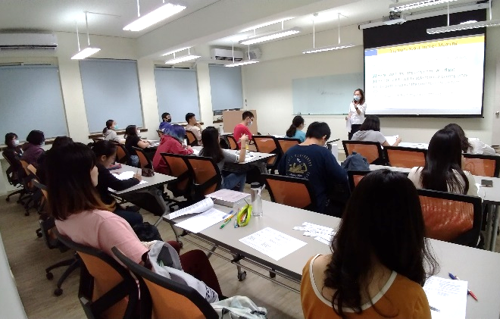
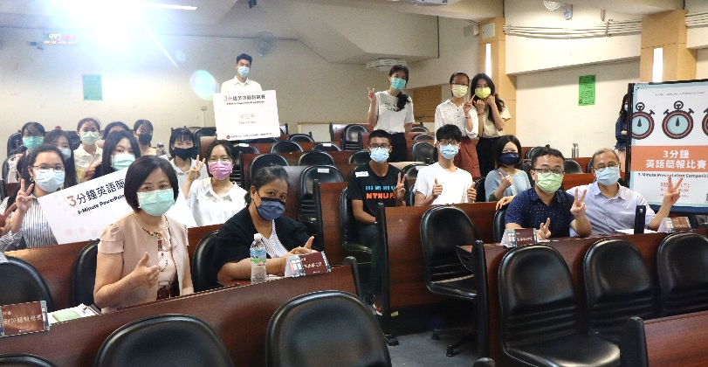
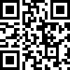
大學專業只能使用一種語言學習嗎?
(2)英語增能活動
英語聊天室
英語聊天室於平日朝十晚五開放，同學不需事先預約，到場即可和該時段的口說輔導員進行英語會話。同時備有線上聊天室時段，讓英語口說練習不受空間與距離的限制。
英語工作坊
外文組每學期開辦數場次英語增能工作坊，讓同學在課餘時間也能透過短期課程精進英語能力。
英語競賽
外文組定期舉辦全校性英語競賽，備有高額獎金，歡迎同學來挑戰！
-三分鐘英語簡報競賽
-英語朗讀競賽
-英語看圖說故事競賽
共教外文組網站：https://reurl.cc/A1xoAp

Slide 39
Can I study in another language?
(2) English Enhancement Activities
English Chat Room
The English Chat Room is open from Monday to Friday, 10 am to 5 pm. No appointment is necessary. Students may simply show up and chat with the Speaking Tutor on duty. The Online Chat Rooms are also available at specified times, making English speaking practice free from the bound of space and distance.
English Workshop
To provide students with a chance to enhance their English proficiency, the Foreign Language Division of Common Core Education also holds several English workshops each semester.
English Competition
The Foreign Language Division of Common Core Education regularly holds university-wide English competitions with big prizes, so come and take on the challenge!
-Three-minute English Presentation Competition
-English Reading Competition
-English Story-telling with a Picture Competition
Website：https://reurl.cc/A1xoAp

Slide 40
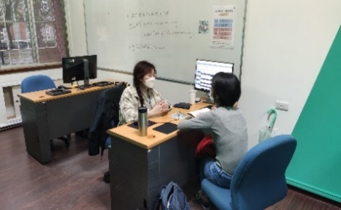
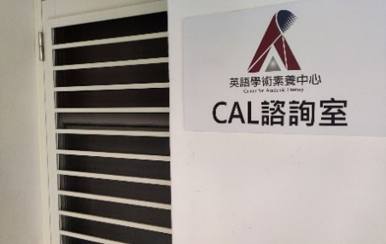
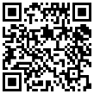
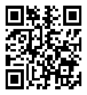
大學專業只能使用一種語言學習嗎?
(3)英語學術寫作與口說諮詢
英語學術素養中心（Center for Academic Literacy, CAL），聘用本校優秀博碩士生協助各領域學生修習全英語授課課程。
英語學術寫作輔導：提供英文論文、報告和作業等給予架構組織、論述邏輯、文法用字和格式等建議，但不提供翻譯、逐字修訂、校對、潤飾等服務。
英語學術口說輔導：提供英文課堂討論與報告、論文口語簡報與口試、碩博士班及交換學生申請面試等給予主題、字句、語意、語用情境與文法、發音等建議，但不提供求職面試、職場會話、生活會話輔導。
說明：
（1）時間：早上9－12點以及下午14－17點
（2）地點：CAL諮詢室
（3）諮詢時間：一小時
（4）預約方式：採預約制，不接受現場報名（預約方式請上官網查詢）
（5）聯絡請洽02-7749-5902 或 calntnu101@gmail.com
CAL網站： https://www.cal.ntnu.edu.tw/
CAL粉絲專頁：https://www.facebook.com/ntnucal

Slide 41
Can I study in another language?
(3) English Academic Writing and Speaking Torturing
Center for Academic Literacy (CAL) has recruited exceptional master’s and doctoral students to help students take English medium instruction (EMI) courses in all fields .
English Academic Writing Tutoring: Provides guidance on structure, organization, argumentation, grammar, word choice, and format for English theses, reports, and assignments. Services will exclude translation, revisions, proofreading, and editing.
English Academic Speaking Tutoring: Provide suggestions on topics, vocabulary and phrasing, semantics, language use context and grammar, and pronunciation for English classroom discussions and presentations, oral defenses, interviews for master’s or doctoral programs, and interviews for exchange student programs. Services will exclude tutoring for job interviews, business communication, and daily conversation.
Details：
（1）Time: 9:00 - 12:00 and 14:00-17:00
（2）Location: CAL Tutoring Room
（3）Duration: 1 Hour
（4）Appointment: By appointment only. No walk-ins will be accepted. (To make an appointment, please visit our official website)
（5）Contact Information : 02-7749-5902 或 calntnu101@gmail.com
CAL website： https://www.cal.ntnu.edu.tw/
CAL FB：https://www.facebook.com/ntnucal

Slide 42
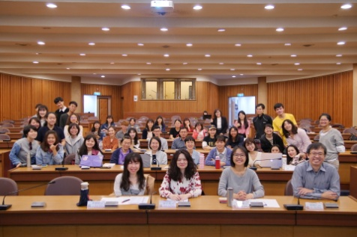
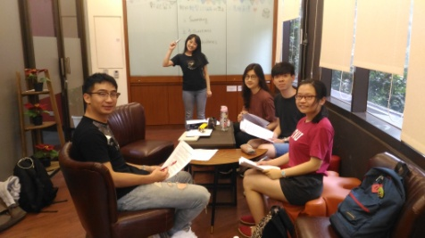
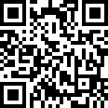
大學專業只能使用一種語言學習嗎?
(4)英語讀書會 English Reading Group
想增強自己的英語閱讀能力和口語表達能力嗎? 透過參與英語讀書會，你可以跟來自全球不同國家的外籍生互動！主題多元、時段彈性，透過小組討論，讓你熟悉英語閱讀、輕鬆開口說英語！
凡本校在學學生，於每學期申請時限內至線上報名，活動無需任何費用，報名依志願分配組別，經通知確認後即可參與。每學期將召募本校外籍生或英語表現優異之同學擔任帶領人，共同規劃多樣化主題與自選時段，並於學期間領讀至少6次討論活動。每學期活動時間表會公布於讀書會網站，敬請關注讀書會網站與圖書館最新消息。
讀書會網站：https://subjectguide.lib.ntnu.edu.tw/readinggroup
相關事項敬請洽詢圖書館推廣諮詢組 libservice@deps.ntnu.edu.tw 02-77495250

Slide 43
Can I study in another language?
(4) English Reading Group
Do you want to improve your English reading and speaking proficiencies further? Through English Reading Groups, you will be able to meet students from all over the world. With a wide range of topics and flexible schedules, English Reading Groups will help you read and speak English with ease!
Reading Group website：https://subjectguide.lib.ntnu.edu.tw/readinggroup
Please contact the Library for any inquiries：libservice@deps.ntnu.edu.tw 02-77495250

Slide 44
大學專業只能使用一種語言學習嗎?
(5)英檢補助
本校日間學制大學部及碩、博士班學生於在學期間參加多益、托福、雅思、全民英檢等英文相關檢定考試並達CEFR B2獎勵標準者，將補助報名費用。每人於在學期間以獲得乙次獎勵為限。
共教外文組網站：https://reurl.cc/A1xoAp

Slide 45
Can I study in another language?
(5) English Certification Exam Subsidy
Undergraduate and graduate students while being enrolled as an NTNU student have attained CEFR B2 in English certification exams such as TOEIC, TOEFL, IELTS, and GEPT will qualify for a reimbursement of their exam registration fees. Each student is limited to one reimbursement only.
Website ：https://reurl.cc/A1xoAp

Slide 46
大學只能在臺灣讀？
學長姐分享
當決定要出國就讀研究所時我開始用3W(Why、Where、What) 問自己，檢視自己究竟為什麼要出國、想到哪裡升學和想要讀什麼，等確立後便開始著手準備資料。在大三下時除了幫忙教授做研究外，基本上不太參與系上活動了，每天沒有課堂就讀英文，休息時間也會搜尋一下美國學校資訊、準備CV、SOP等資料。因為沒有請代辦的關係，我會利用Excel整理各所學校資料，並列明各校要求的文件以及截止日期。另外，我也在這段時間積極尋找資源，向曾經出國或是正在國外就讀的朋友、家人詢問相關問題及幫忙檢閱我的英文文章。
Why not? 是我之前和一位在台灣學習中文的土耳其朋友聊天時他給我的答案，當時我問他為什麼他有勇氣只因為看了一部華劇就隻身來台灣學習中文。他則反問我為何不呢，人生就僅僅一次，當內心渴望著一件事時，不管是出國唸碩士或是到國外交換等等，都該盡自己最大的能力去執行，坐而言不如起而行。因此每當我自己在猶疑不定、不敢冒險嘗試、不想跳脫舒適圈時，這兩個字總會提醒著我，為何不給自己一個機會。
公民教育與活動領導學系

Slide 47
Do I always have to be in Taiwan to earn my degree?
Experience Sharing
When I was trying to decide whether to go abroad for graduate schools, I asked myself the 3Ws (Why, Where, and What). I wanted to examine why I want to go abroad, where I want to go, and what I want to study? As soon as I have made up my mind, I started preparing. In the 2nd semester of my junior year, other than helping my professor do research, I basically stopped attending department activities. I started studying English day and night. During breaks, I would also look for information on schools in the US, prepare my CV and so on. Because I did hire a professional study-abroad service, I would use Excel to make a chart of all the information I gathered, and list their application requirements and deadlines. Moreover, I also actively searched for additional information, asked friends and family who are currently studying abroad or had been abroad for relevant information, and help me check my English papers.
“Why not?” is what my Turkish friend said. She was studying Chinese here in Taiwan and I asked her how she got the courage to come, especially since she decided to come simply because of a Taiwanese TV drama. But she countered by asking me why not? We only live once. When we want to do something, no matter what it is, we should always try our best to realize it. So whenever I get indecisive, fear the unknown, and hesitate to leave my comfort zone, I would always think of these two words, so why not give ourselves a chance?
Department of Civic Education and Leadership

Slide 48
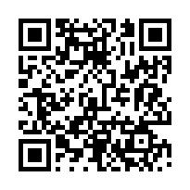
大學只能在臺灣讀？
年輕人，你的舞台不在台灣，在全世界！師大姊妹校林立，請給自己暢讀世界、擁抱國際的機會。
(1)雙聯學位
只要符合雙方學校的畢業資格，可以取得兩校學位。
本校雙聯學位型態有3+2 學碩雙聯、1+1碩士雙聯、2+2博士雙聯。
(2)交換生
繳本校學費，體驗國外大學上課、生活方式，拓展國際視野。
出國交換至少要選修該校二門課程或六學分。
我們姊妹校資料總覽(2022.2.17統計)
 | 美洲 | 歐洲 | 亞洲 | 非洲 | 大洋洲 | 合計
合作國家數 | 6 | 22 | 13 | 1 | 2 | 44
姊妹校 | 63 | 100 | 214 | 1 | 11 | 389
MOU | 69 | 114 | 288 | 1 | 13 | 485
學生交換 | 33 | 85 | 201 | - | 5 | 324
教師交換 | 14 | 14 | 16 | - | 2 | 46
雙聯協議 | 13 | 9 | 17 | - | - | 39
其他 | 9 | - | 6 | - | - | 15
赴外短期研習資訊可至本校國際事務處查詢： 首頁/學生專區/赴外就讀及短期研習/赴外交換生
https://bds.oia.ntnu.edu.tw/bds/web/outgoing-info
雙聯學制資訊諮詢：mika.ma@ntnu.edu.tw
赴外交換資訊諮詢：outgoing@deps.ntnu.edu.tw

Slide 49
Do I always have to be in Taiwan to earn my degree?
Young wo/man, your stage is not here in Taiwan, it’s in the world! With NTNU’s sister universities all over the globe, give yourself a chance to explore the world!
(1) Joint Degrees
To receive two degrees from two universities, the student must meet all the qualifications and graduation requirements of both universities.
Joint Degrees at NTNU can be a 3+2 years Bachelor-Master’s Joint Degrees , 1+1 years Master’s Joint Degrees or a 2+2 Doctorate’s Joint Degrees .
(2) Exchange Students
Students would pay NTNU tuition while broadening one’s horizon through studying and living overseas.
Students are required to take at least two courses or 6 credit hours during their exchange.
NTNU Sister Universities Overview (as of Feb. 17, 2022)
 | Americas | Europe | Asia | Africa | Oceania | Total
# of Countries | 6 | 22 | 13 | 1 | 2 | 44
Sister Universities | 63 | 100 | 214 | 1 | 11 | 389
MOU | 69 | 114 | 288 | 1 | 13 | 485
Student Exchange | 33 | 85 | 201 | - | 5 | 324
Professor Exchange | 14 | 14 | 16 | - | 2 | 46
Joint Degree Agreement | 13 | 9 | 17 | - | - | 39
Other | 9 | - | 6 | - | - | 15
For short-term study abroad information,
please visit the Office of International Affairs website：https://bds.oia.ntnu.edu.tw/bds/web/outgoing-info
Joint degree information：mika.ma@ntnu.edu.tw
Foreign exchange information：outgoing@deps.ntnu.edu.tw

Slide 50
大學只能在臺灣讀？
(3)本校各類境外短期研修補助
◎個人申請
教育部
學海飛颺
學海惜珠
選送清寒優秀學生赴外國大學院校修讀學分
(應為列入教育部參考名冊之國外學校，不含大陸及港、澳)。
本校
本校晨光圓夢境外研修助學計畫
選送優秀學生赴外國大學院校修讀學分
(應為列入教育部參考名冊之國外學校，不含大陸及港、澳)。
本校鼓勵學生赴境外進修補助
期程以一學期(季)或一學年為原則，補助額度每人新臺幣6萬元以上12萬元以下。
由本校國際事務處於每年11月公告簡章，2月底截止收件。
期程以一學期(季)或一學年為原則，補助額度依學生資料評核，由教育部決定。
選送清寒優秀學生赴大陸及港、澳大學院校修讀學分。
由本校國際事務處於每年11月公告簡章，2月底截止收件。
選送優秀學生赴境外大學院校修讀學分
(赴外之境外學校包括大陸及港、澳)。
期程以一學期或一學年為原則。
期程以一學期或一學年為原則。
由本校國際事務處於每年4月、10月公告收件。
由本校國際事務處於每年4月、10月公告收件。
學海飛颺/學海惜珠補助諮詢、短期赴外研修補助諮詢：oiagrants@ntnu.edu.tw
晨光圓夢境外研修補助諮詢：e51014@ntnu.edu.tw

Slide 51
大學只能在臺灣讀？
(3) Short-term International Exchange Funding
◎Individual application
Ministry of Education
International Education
Exchange Division
Help send selected underprivileged students overseas to study in foreign universities. (Foreign universities, excluding universities in Mainland China, Hong Kong, and Macau, must be listed in the MOE Reference Register)
NTNU
NTNU Chen Guang (Morning Light) Subsidies on Overseas Study
Will send selected students overseas to study in foreign universities. (Foreign universities, excluding universities in Mainland China, Hong Kong, and Macau, must be listed in the MOE Reference Register)
NTNU Subsidies on Overseas Study
In principle, the duration shall be one semester (quarter) or one academic year. Funding range will be between NT$60,000 and NT$120,000 per person.
Details will be announced by the NTNU Office of International Affairs in November of each year. Deadline for applications will be the end of February each year.
In principle, the duration shall be one semester (quarter) or one academic year. MOE will determine the amount of funding in a case-by-case basis.
Help send selected underprivileged students overseas to study in Mainland Chinese, Hong Kong, and Macau universities.
Details will be announced by the NTNU Office of International Affairs in November of each year. Deadline for applications will be the end of February each year.
Help send selected students overseas to study in foreign universities. (including universities in Mainland China, Hong Kong, and Macau)
In principle, the duration shall be one semester or one academic year.
In principle, the duration shall be one semester or one academic year.
The NTNU Office of International Affairs will announce the details and start receiving applications in April and October of each year.
The NTNU Office of International Affairs will announce the details and start receiving applications in April and October of each year.
International Education/ Exchange Division、 Subsidies on Overseas Study information ：oiagrants@ntnu.edu.tw
Chen Guang (Morning Light) Subsidies on Overseas Study information ：e51014@ntnu.edu.tw

Slide 52
大學只能在臺灣讀？
(3)本校各類境外短期研修補助
◎系所申請
教育部
學海築夢
新南向學海築夢
選送優秀學生赴新南向國家具發展潛力之企業、機構進行職場實習。（赴外國家限新南向國家等十八國）。
期程至少連續30天。
由本校國際事務處於每年1月和7月公告簡章並受理各系所申請。
期程至少連續30天。
由本校國際事務處於每年1月和7月公告簡章並受理各系所申請。
選送優秀學生赴國外企業、機構進行職場實習（赴外國家不含新南向國家、大陸及港、澳)。
學海築夢/新南向學海築夢補助諮詢：e51014@ntnu.edu.tw

Slide 53
大學只能在臺灣讀？
(3) Short-term International Exchange Funding
◎Department application
Ministry of Education
Overseas Internship Program
Minimum term is 30 continuous days.
Internships in corporations and organizations abroad for outstanding students (excluding New Southbound Policy countries, Mainland China, Hong Kong and Macau)
The Office of International Affairs of NTNU will publish application information and start accepting applications from departments and institutes in January and July.
The New Southbound Overseas Internship Program
Internships in corporations and organizations with developmental potential in New Southbound Policy countries for outstanding students. (Destination is limited to the 18 countries stipulated in the New Southbound Policy).
Minimum term is 30 continuous days.
The Office of International Affairs of NTNU will publish application information and start accepting applications from departments and institutes in January and July.
Overseas Internship Program/ The New Southbound Overseas Internship Program information：e51014@ntnu.edu.tw

Slide 54
大學只能在臺灣讀？
(4)海外留學
海外留學不是夢，從大一開始就可以提早做準備，贏在起跑點！
搜尋自己理想的學校
可透過參加教育展、瀏覽大學排行網站與相關論壇、諮詢留學代辦中心、詢問有經驗的學長姐等方式了解適合自己的科系與學校。
瀏覽各大學入學申請資訊
看中幾所心儀的學校後，便可至各大學的官方網站查看詳細的入學資訊，通常會擺在”Prospective”、”Students”或者”Admission”等專區。
檢核自己應具備之條件
例如GPA、GRE、TOFEL的成績規定，有些學校採認IELTS的分數，是否需要作品集或其他的檢定證明等，可預先知道，在大學四年好好規畫準備。
安排申請時間軸
每一間學校的收件期程與表單不盡相同，為不錯過任何機會，幫自己制定申請學校的時間軸，其中包含相關檢定考試的日程、各校收件日期、郵寄工作天、兵役等。
萬事俱備，就等入學通知了！

Slide 55
Do I always have to be in Taiwan to earn my degree?
(4) Going Abroad
Going abroad to study is not just a dream! Get a head start by preparing as soon as you enter the university.
Find your ideal university Find a major and university that best suit you through attending fairs, browsing university ranking websites and forums, consulting professional agencies, and asking those who had similar experiences.
Browse the application information of each university After narrowing down to a few candidate universities, go online and check out their admissions information. This information can usually be found under the labels of “Prospective Students”, “Students”, or “Admissions”.
Examine the requirements Check all the admissions requirements such as GPA, GRE, TOFLE, etc. Some universities will require IELTS. Please also check to see if a portfolio, or other certifications are required. The sooner you know what the requirements are, the more time you will have to prepare for the applications.
Schedule your applications The application timeframe of each university or program will be different. Make sure to schedule ahead, this includes taking the necessary tests, and knowing all the deadlines, the number of days required for the application to be delivered, and military draft regulations (if applicable).
After you have sent out all the application materials, just sit back and wait for the results!

Slide 56
大學畢業後進修管道?
學長姐分享
我去年就推甄上本科系的研究所，雖然曾經想過要放棄推甄的管道，用更多時間考慮是否要實習或考其他相關科系，但我認為以我的能力、領域和目標而言，直升是適當的選擇，於是便留在這裡。
我認為研究所的學習型態和大學有很大的不同，壓力和責任也會比較大，所以首先應該思考自己是否真的有就讀研究所的需要，常見的就讀理由大多是想要走學術研究或是想要更高的起薪，其次，也要去了解除了畢業論文以外，還有哪些事情是你可能會遇到的，例如：要累積多少投稿小論文的「點數」才能畢業，有時也需要協助競賽活動或行政上的事務，若你在猶豫畢業後是否要再進修，或不確定自己適不適合讀研究所，那麼了解這些事將能協助你做決定，避免努力考上研究所之後發現和自己想像中的不一樣。
探索自己喜歡或擅長的領域是很重要的，畢竟你需要用很多時間閱讀文獻並撰寫論文，研究自己感興趣的內容自然會比較能保持熱忱，寫論文的過程也會比較有意義，所以我決定進修前就要求自己想要探討的議題，避免升學後像個無頭蒼蠅、不知道自己要做什麼。
科技應用與人力資源發展學系

Slide 57
Continuing education post-graduation
Experience Sharing
I was admitted into my department’s graduate program last year. Although I had thought about not applying, and instead, spend more time to think about whether I should do an internship or apply to other related fields, in the end I still decided that given my abilities, field, and goals, direct admission will be the right choice. This is why I stayed. I think graduate school will be very different from college. The stress and responsibilities will both be greater. So first we have to think if we have a need to go to graduate school. The most common reasons for going to graduate school are wanting to do academic research, or have a higher start salary. Then, we also have to know what to expect in addition to the thesis. For example, how many papers do you have to publish before you can graduate? Do we have to compete in certain competitions? Or are there other administrative issues?
If you are wondering if you should continue your studies after graduation, or are unsure if graduate school is right for you, knowing the answers to these questions will help you decide. This can prevent a lot of unexpected surprises once you get into graduate schools. It is important to explore and find out what you like or what you are good at. After all, you will be spending a lot of time reading literature and writing thesis. Doing something you enjoy will naturally make it easier to stay motivated, and make the whole process more meaningful. So I made myself think about what topics I want to explore before I even got in, to ensure that I wouldn’t be running around like a headless chicken, not knowing what I want to do.
Dept. of Technology Application and Human Resource Development

Slide 58
大學畢業後進修管道?
(1)參加甄試或考試進入碩士班就讀
大學成績優異進入本校碩士班者，可申請新生入學成績優異獎學金喔！
 | 碩士班甄試入學 | 碩士班招生考試 | 教師/碩士在職專班 招生考試
簡章公告 | 每年9月初 | 每年11月 | 每年11月
考試日期 | 每年10-11月 | 每年2-3月 | 每年2-3月
特色 | 大部分系所免筆試，學生可透過申請、面試等招生程序進入本校碩士班就讀，提早畢業的學士班學生亦可於甄試錄取後申請碩士班提前入學（即2月入學），達到連貫學習目標。 | 學生透過書面審查、筆試、面試等招生程序進入本校碩士班就讀。 | 針對已進入職場工作的學生，提供在職進修管道，學生可善用夜間、週末或暑期的時間進修學習，以取得碩士學位。

Slide 59
Continuing education post-graduation
(1) Applying to Master’s Program
New student scholarships are available to those who qualify!
 | Admission through Application | Admission through Exams | Admission to In-service Programs through Exams
Announcement | Early September each year | Every November | Every November
Exam/Interview Dates | Every October-November | Every February-March | Every February-March
Features | Most departments do not require written exams. Student may be admitted through application and interviews. Students who graduated early may apply to enter their master’s program early after they have been admitted (i.e., in February). | Students will be admitted through application reviews, paper-based examinations, and interviews. | Master’s programs that are aimed at working professionals. Courses of these programs will be offered in the evenings, weekend, or during summer holidays.

Slide 60
大學畢業後進修管道?
(2)連續修讀學、碩、博士學位
對學術研究有興趣的學生，可及早確立志向，在大學階段即可申請碩士學位先修，或逕讀博士學位。
 | 碩士學位先修 (五年連續修讀學、碩士學位) | 逕修讀博士學位
辦理時程 | 每年暑期 | 每年2月、9月公告招生簡章
申請資格 | 本校修畢大二課程之大三、大四學生可於每年暑假透過甄選，成為該系(所)的「碩士班先修生」，俟正式透過碩士班甄試、碩士班招生考試成為本校研究生後，其於學士班所上修之碩士班課程，除已計入學士班畢業學分數之大碩合開科目外，均得全部申請抵免。 | 學士班應屆畢業生、碩士班成績優異、具有研究潛力之在校生，可檢具申請書、歷年成績單，經原就讀或相關系、所、院、學位學程助理教授以上2人推薦，並經擬就讀系、所、院、學位學程之相關會議通過及校長核定，直接攻讀博士學位。學生亦可申請至領域相近之系所修讀。
Notes:
教務處研究生教務組

Slide 61
Continuing education post-graduation
(2) Direct Admission to Master’s and Doctoral Programs
Students who are interested in academic research can start early by applying for direct
admissions to master’s and doctoral programs while they are still in college.
 | Direct Admission to Master’s Programs (5 year Bachelor’s + Master’s degrees) | Direct Admission to Doctoral Programs
Timeframe | Every Summer | Announcements will be made every February and September
Qualification | Students who have completed two years of undergraduate coursework (i.e., Juniors and Seniors) may apply to become a “Master’s Degree Advanced Placement Student”. All of the master’s level credits will be counted towards their Master’s Degree if/when these students are admitted to an NTNU Master’s Program. However, credits that were counted towards the student’s Bachelor’s degree will be excluded. | Graduating undergraduates or master’s students who excelled in their studies and have shown strong potential in research work, are eligible to apply. Along with the application form, applicants should also submit their transcript and two recommendation letters from professors (assistant professors or above) of their respective fields, departments, institutes, college, or degree programs. Direct Admission into Doctoral Programs have to be approved by relevant departments, institutes, degree programs, and the President of the university. Students may also apply to programs in fields that are different from but are still related to their original field(s) of study.

Slide 62
CH 6
大學只有在教室學嗎?
學長姐分享
學長姐分享
現在非傳統學習的方式有許多種，課業輔導社群是其中之一。課業輔導社群是高自發性的群體，參加與否完全決定於自己。成效高低正相關於自己的參與程度。
若積極參與且同儕之間有良好互動的狀況下，在分享自身經驗與參考其他人的想法可以激盪出很不一樣的火花，課業輔導社群的功能才會充分發揮。身為號召人，我認為課業輔導社群能讓想要在課餘時間討論課業的同學們有個機會大家一起討論問題找答案。
本課輔培養學生對於微積分的積極學習，並輔導學習成效不彰的學生，實行漸進式的教學，最基本目標是參加課輔的學生順利通過。透過開辦課輔，利用課餘時間來進行學習，並由助教講解來釐清觀念，親自練習題目加深印象，熟能生巧，進而提升其學習上的成就感：也建立起他的信心，以期對於科學領域產生廣泛的興趣。
在實際舉辦過後，不少學弟妹也覺得受益良多，也因為有課業輔導社群的幫助下，期中考與期末考前有複習進度，使他們的考試能夠拿到不錯的成績，所以我認為有意願課後學習的同學很適合找幾個志同道合的同學共組課業輔導社群。
機電工程學系

Slide 63
CH 6
Does learning always have to be inside classrooms?
Experience Sharing
There are many kinds of non-traditional ways of learning nowadays, one of which is study groups. Study groups are highly voluntary groups. People will decide on their own if they want to join, and the effect is positively correlated to how deeply involved they are. If students actively participated and had good interactions with their peers, they can get a lot out of this through sharing their own experiences and taking other’s thoughts into consideration. This is how a study group can really work. As a founder of a study group, I think study groups can give those who wish to discuss about their classwork outside of classrooms a chance to gather and find the solutions together.
My study group encourages students to learn calculus, and help those who are struggling. We take it step-by-step, and the most basic goal is to help our members get a passing grade. Through starting a study group, using our own free time to learn, and having TAs explain the content and show how the math is done, can give learners a stronger impression, improve their skills through practice, and ultimately give them a sense of accomplishment in learning. Not to mention giving students confidence, and hopefully lead to a broad interest in the sciences.
At the end of the study group, many participants found the experience beneficial. And with the assistance of the study group, with its help sessions before the midterm and the final, they got pretty decent grades. So I think those who want to study outside of the classroom will be quite suited to find a few other likeminded people and form a study group.
Dept. of Mechatronic Engineering

Slide 64
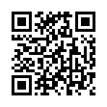
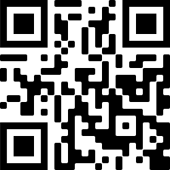
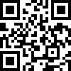
CH 6
大學只有在教室學嗎?
唯有透過自我發現、自我學習，不斷地探勘挖掘，視界會愈來愈深邃，心胸會愈來愈寬廣，內在之河會愈來愈豐沛。
(1)Moodle 數位學習平臺
你的教室不在教室，而在Moodle 。未來四年，Moodle 會與你常相左右。
在「Moodle」你會看到老師的課程大綱、教學進度、作業說明。還有「作業區」、「討論區」、「線上測驗」等功能。臺師大目前所有課程以及教師皆運用此平臺；若你沒有隨時登入 Moodle，可能就會活在沒有去上課，不知道教室發生甚麼事的孤獨世界。
聯絡電話：02-7749-5579
數位學習平臺網址： https://moodle3.ntnu.edu.tw/
(2)圖書館
臺師大擁有全國大專院校第二大館藏量的圖書館，重視文化傳承，致力知識的創造、應用、傳播與保存，進而成為推動學術與教育的核心力量。
https://www.lib.ntnu.edu.tw/
(3)課業輔導學習社群
為輔導與協助學習困難學生，臺師大教學發展中心設立課業輔導學習社群，由相關系所教師與學生組成，以同儕輔導方式協助學生度過學習難關。
教學發展中心課業輔導學習社群網址：https://ctld.ntnu.edu.tw/

Slide 65
CH 6
Does learning always have to be inside classrooms?
Your horizon and mind will only broaden and enrich through tireless self-exploration and self-learning
(1) Moodle – A Digital Learning Platform
Your classroom is not in a classroom, but on Moodle. In the next four years, Moodle will be a big part of your life. On Moodle, you will see all the syllabi, the progress of the course, assignment instructions, with functions of “Assignments”, “Forums”, “Online Assessments” etc. Currently, all courses and instructors at NTNU have been using Moodle. So always go online and check your Moodle, or be left out of the loop!
Contact Tel：02-7749-5579
For details, please go on Moodle：https://moodle3.ntnu.edu.tw/
(2) Libraries
NTNU library boasts the second largest collection among all Taiwanese universities. Our libraries also offer extensive services to all students and faculties, providing top-notch support to research and learning.
https://www.lib.ntnu.edu.tw/
(3) Study Groups
NTNU’s Center for Teaching and Learning Development has created a mechanism for students to setup study groups. The groups will be formed by students under the guidance of an instructor, and will aim to help students academically through peer collaboration and mutual assistance.
Center for Teaching and Learning Development：https://ctld.ntnu.edu.tw/

Slide 66
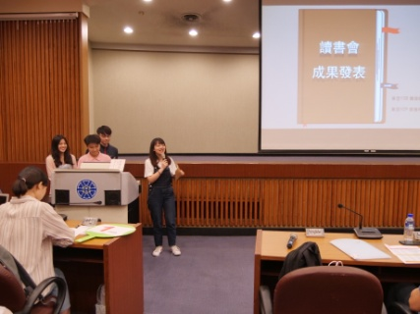
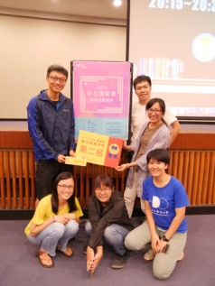
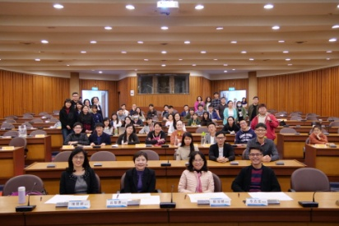
CH 6
大學只有在教室學嗎?
(4)讀書會
學習如入桃花林，旅途上落英繽紛，企盼能一同領略彼此眼中的美。
【自主讀書會】
為鼓勵同儕交流並促進閱讀學習，凡本校在學學生五人（含）以上，至多十人，不限系所皆可組成讀書會，於每學期申請時限內，填寫申請表與計畫書向圖書館提出，申請項目含「專業經典」、「專題討論」、「教學研討」、「成長探索」等主題。經審查後公告錄取，並於指定日期內繳交「簽到暨紀錄表」、「成果報告書」後，將可獲得補助，盼同學皆能合作學習！每學期開學即開放申請，敬請關注讀書會網站與圖書館最新消息。
讀書會網站：https://subjectguide.lib.ntnu.edu.tw/readinggroup
相關事項敬請洽詢圖書館推廣諮詢組： libservice@deps.ntnu.edu.tw 02-77495250

Slide 67
CH 6
Does learning always have to be inside classrooms?
(4)Reading Groups
The journey of learning should be enjoyed and shared with likeminded company
【Reading Groups】
To encourage the formation of cohorts and learning through reading, all NTNU students are eligible to form reading groups. A reading group should consist of at least 5 students. Applications and proposals are due within the first two weeks of each semester. Funding will be provided once the applications are approved.
Reading Group website：https://subjectguide.lib.ntnu.edu.tw/readinggroup
Please contact the Library for any inquiries：libservice@deps.ntnu.edu.tw 02-77495250

Slide 68
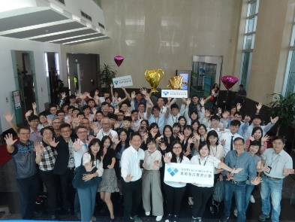
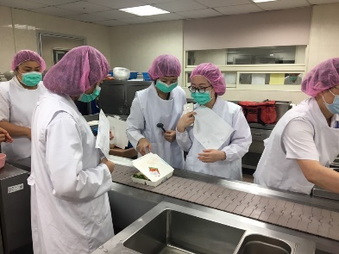
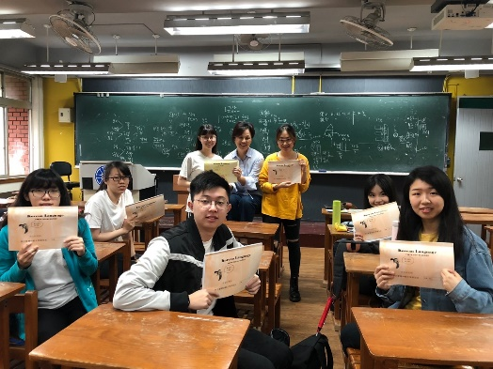
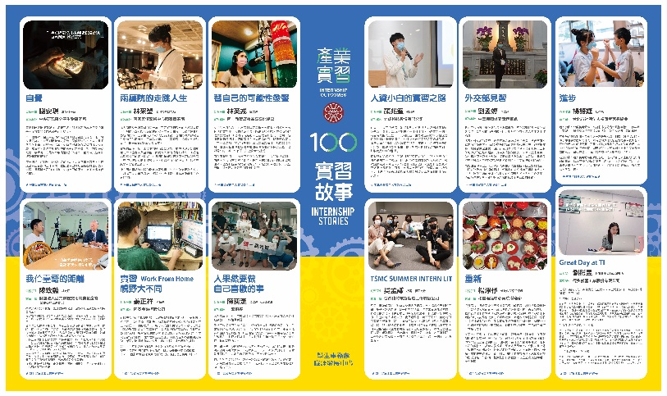
CH 6
大學只有在教室學嗎?
(5)研討會、工作坊、講座
目不暇給，豐富多元的研討會、工作坊、講座，每天在校園各種場合舉辦，別猶豫，走進去參加，學到賺到，這才是大學生活。
(6)產業實習
實務印證理論，學與用合一，釐清未來職涯方向，為自己的就業競爭力加分，請大膽的走出校園實習去。
Notes:
產業實習1110225學務處職涯發展中心許瑋庭秘書更新

Slide 69
CH 6
Does learning always have to be inside classrooms?
(5) Seminars, workshops, lectures
Conferences, workshops, and lectures that cover topics of all fields in depth are held on campus all year round. Don’t miss out on these exciting opportunities of learning and make the most out of your college years.
(6) Industry Internships
Put theory into practice! This is the only way to keep you motivated with learning. Whether go abroad or into a factory, bravely go where you have never been before.
Notes:
產業實習1110225學務處職涯發展中心許瑋庭秘書更新

Slide 70
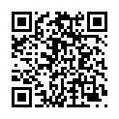
CH 7
哪些行為違反了學術倫理呢？
你已具備學術研究的倫理知識了嗎？
請注意，下列行為都違反了學術倫理喔！
這些態樣內容節錄自教育部「專科以上學校學術倫理案件處理原則」。
違反學術倫理的態樣
造假：虛構不存在之申請資料、研究資料或研究成果。
變造：不實變更申請資料、研究資料或研究成果。
抄襲：援用他人之申請資料、研究資料或研究成果未註明出處。註明出處不當，情節重大者，以抄襲論。
由他人代寫。
未經註明而重複出版公開發行。
大幅引用自己已發表之著作，未適當引註。
以翻譯代替論著，並未適當註明。
詳看法規全文
教務處研究生教務組 電話:02-77491097

Slide 71
CH 7
What will violate academic ethics?
Do you have a sufficient level of knowledge about academic ethics?
Please be aware that all of the following are in violation of academic ethics!
Acts that are in violations of Academic Ethics
The violations listed here are based on the “Directions for the Resolving of Academic Ethics Cases in Educational Institutions (Junior College and above)”.
Fabrication: Fabricating nonexistent application information, research data, or research findings
Fraud: Altering one’s application information, research data, or researching findings.
Plagiarism: Make use of other’s work in their applications, research data, or research findings without proper citation. Extensive or serious violations of citation rules will be viewed as plagiarism.
Ghostwriting
Reprinting published works without notation
Citing one’s own work extensively without proper notation
Translating published works without notation
For complete Directions (Traditional Chinese only)
Graduate Studies Division, Office of Academic Affairs TEL: (02) 77491097

Slide 72
CH 8
學習地圖
✎規劃四年學習地圖
先思考及規劃學習藍圖 打造你的精彩未來！
 |  | 大一 | 大二 | 大三 | 大四
修課規劃 | 校共同必修(通識、國、英、體..)
 | 系必修、選修
 | 自由選修
 | 雙主修、輔系、學位學程 (需先修學系第一門跨域探索課程) 詳見本冊CH2
國際移動 | 國外雙聯學位、赴外交換 詳見本冊CH4 -語言能力檢定證明(托福、多益、JLPT..) -其他各校要求文件(如成績單、中文或外文自傳(含出國學習計畫)、大學(含)以上優良事蹟或活動證明等)
學習提前 | 提早畢業？ 逕讀博士或學碩五年連修？ 詳見本冊CH1
畢業規劃 | 申請國內外研究所？ 準備就業？ 詳見本冊CH5

Slide 73
CH 8
The Learning Map
✎Map your learning for the next 4 years
Draft a blueprint for your future!
 |  | Freshman | Sophomore | Junior | Senior
Course Plan | University Common Core Education Courses (General Edu., Chinese, Foreign Language, Physical Edu.,…)
 | Departmental Requirements & Electives
 | Electives
 | Double Major, Minor, Degree Program (Completion of at least one departmental Cross-Domain Exploratory Course required)
International Mobility | International Joint Degrees, Foreign Exchange Programs - Language Assessments (TOEFL, TOEIC, JLPT…) - Other Requirements (Such as transcripts, personal statements [including study plans], other certificates)
Academic Plan | Early Graduation? Direct Admission to Doctoral Programs or 5-year Bachelor’s/Master’s Combined Degree Programs?
Post-graduation Plan | Apply to Graduate Programs? Seek Employment?

Slide 74
學會思考、選擇，擁有信念、自由
生涯規劃，從進大學第一天開始！
We wish you a great success！

Slide 75
LEARN TO THINK, BE PRINCIPLED, CHOOSE FREELY
Plan ahead and be prepared. The rest of your life starts now!
We wish you a great success！

